Slide 1



“Mid-Term Project”
LIBRARY MANAGEMENT SYSTEM
Submitted by: Gajendra Shashikant Kulkarni
Submission type : Individual
Name: Library Management System
Batch : 12
LMS Id :
Program : Axis School of fintech.
Date: 29/05/2023

Slide 2

Table of contents
Introduction.
Project Overview.
Architecture Design.
User Interface Design.
Back-end Development.
Front-end Development.
Conclusion.
Future Work.
References.
Appendices.

Slide 3
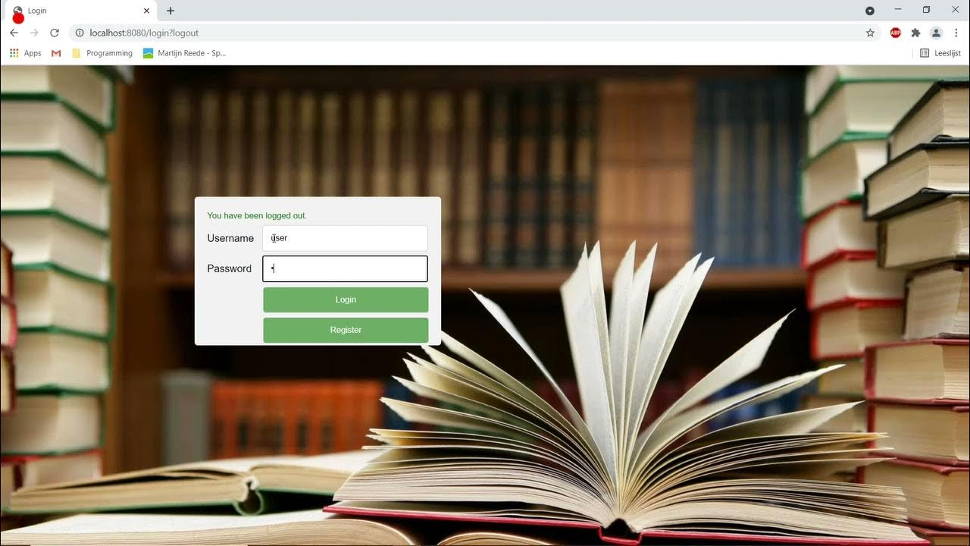
Introduction
The objective of this system is to simplify the library management process, reduce administrative overhead, and improve the overall user experience.
provides features like online catalogs of books , search functionality, reservation systems, and self-checkout options.
The Simple and Small Library Management System Application is a software solution that is designed to manage library resources effectively.
can easily search for books, check their availability, place holds, renew items, and receive notifications.

Slide 4




Project Overview
The Simple and Small Library Management System Application is a critical requirement for managing library resources effectively.
Features and functionalities like User Management: The system should allow the librarian to manage user accounts, including registration, updating user information, and deleting user accounts. Also book Management , Book Search ,Book Borrowing , Book Return, Book Reservation, Book fine Management by user of library.
Technology used
Spring MVC
Mysql Database
spring security
JDBC API
JPA
Thymeleaf

Slide 5
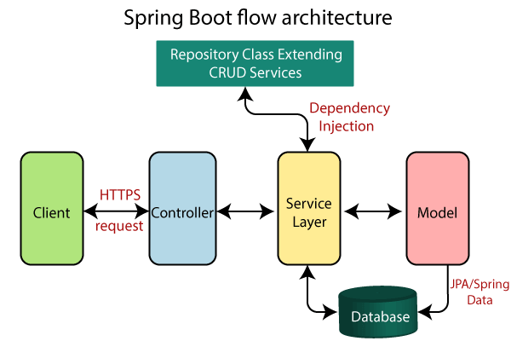
Architecture Design
Front-end:
Thymeleaf: Thymeleaf is used as the templating engine for server-side rendering of web pages.
It allows developers to create dynamic HTML views using Thymeleaf templates, which can be populated with data from the back-end.
Back-end:
Spring MVC -Model-View-Controller it provides the foundation for the back-end of the library management system. It handles HTTP requests, routes them to the appropriate controllers, and processes the logic for various operations.
Spring Security: Spring Security is used for authentication
\and authorization.

Slide 6
Architecture Design
01
JDBC API
Used for database connectivity.
It provides a set of interfaces and classes to
establish connections with the MySQL
02
(Java Persistence API) provides an object-relational mapping framework
It enables developers to map Java objects to database entities and perform CRUD Operation
JAVA PERSISTENCE API
03
MYSQL
MySQL is used as the underlying database management system for storing and managing library-related data

Slide 7
Architecture Design
START
Register as User
Login as User
Login as Librarian
Reserve book
Can Browse Book
Can read FAQ
Access any User
Access any Book
Add new Book
Can See All Books
Search Books by Title
Accept Reservation
Allot new Book to User
LOGOUT

Slide 8
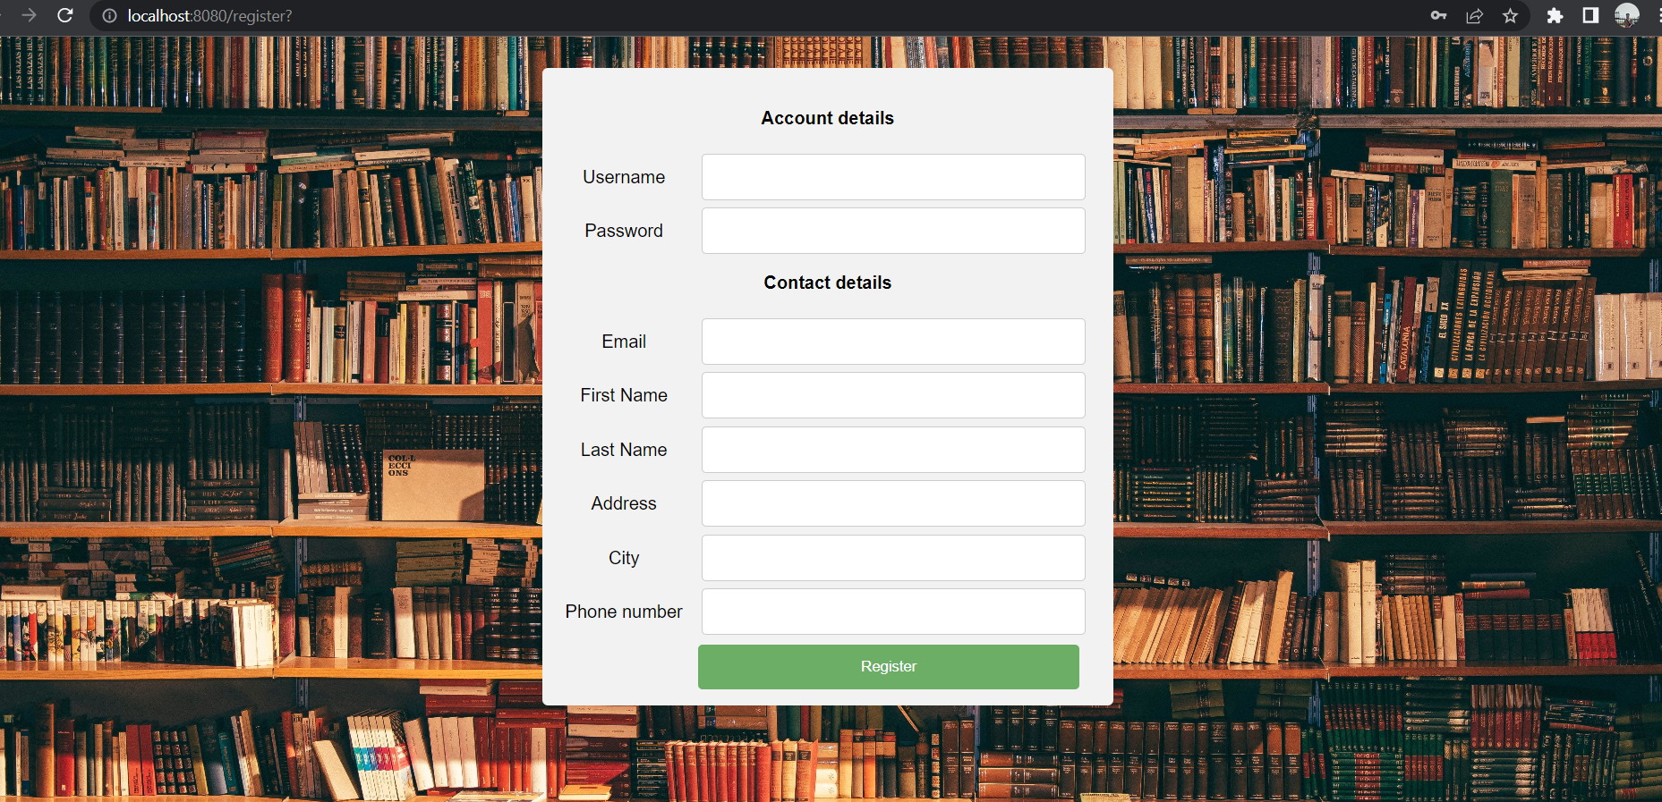
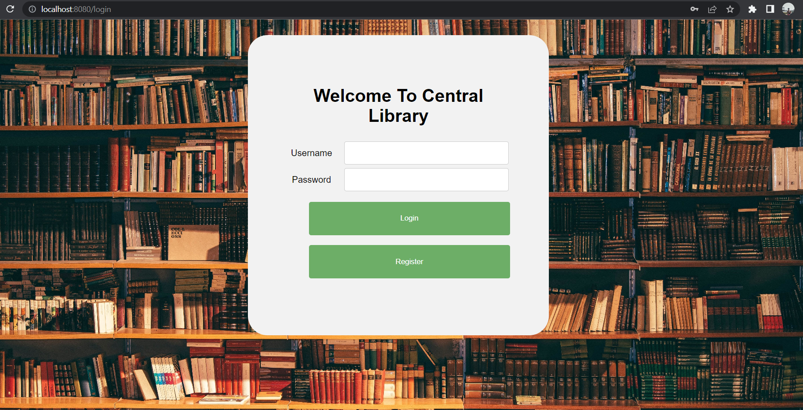
User Interface Design
Components Like:
Header
Container
Buttons
Form for registration

Slide 9
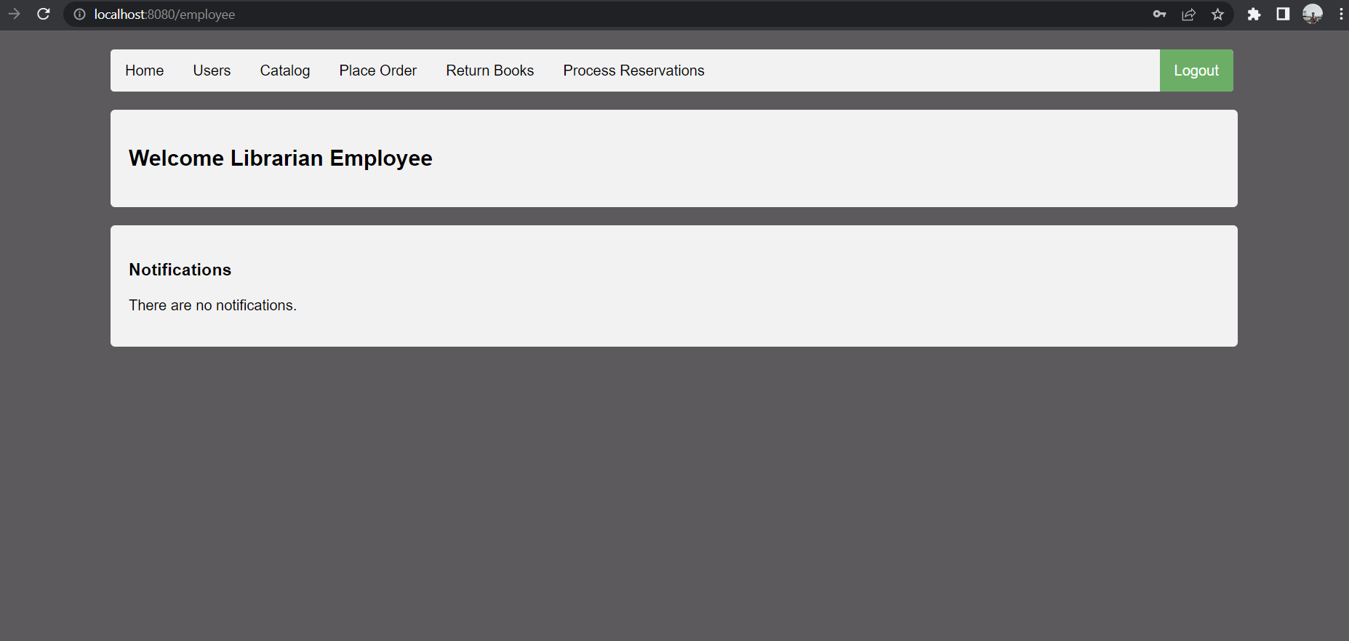
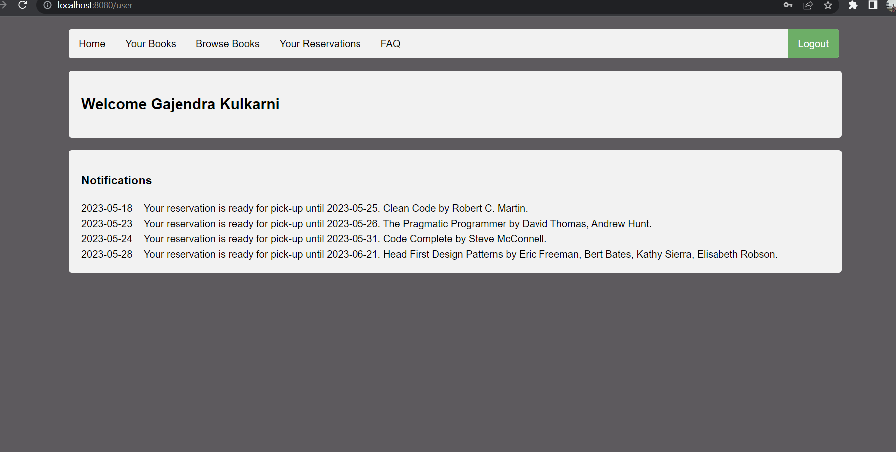
User Interface Design
Components of user UI:
Header
Sidebar
Search functionality
Book listing
Book reservation
FAQ
Components of Librarian UI:
Header,Sidebar
Access Users
Access Books
Return Book
Process Reservations

Slide 10

Back-end Development
The back-end development of this application involves Java as the programming language, Spring MVC for web application development, Spring Security for application security, JPA for object-relational mapping.
The database schema would typically consist of multiple tables that represent different entities and their relationships
eg..Table: Users:Columns: member_id, name, email, address, phone.
Also we are using a many-to-many,
one-to-many relationship between books and Users.
By utilizing the JDBC API, you can establish connections, execute SQL queries, retrieve results, and manage database transactions within your library management system.

Slide 11
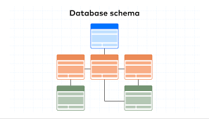
Back-end Development
In a library management system, we are using REST APIs to provide a web service interface for accessing and manipulating library resources.
When implementing the REST APIs, we are using a framework like Spring MVC to handle the request mappings, process the requests, and return appropriate responses. The REST APIs would interact with the underlying database using the JDBC API or an ORM (such as JPA) to retrieve and manipulate data.

Slide 12


Front-End Development.
Thymeleaf
Show Dynamic Data
Apply CSS
Java-based library used to create a web application Supports XHTML/HTML5.
Created Thymeleaf templates for each page or functionality of library management system.
Bind the templates with appropriate controller methods in your Java code.
Thymeleaf tags and expressions to display dynamic data, iterate over collections, conditionally show elements.
For example, if you want to display a list of books, you can use Thymeleaf’s `th:each=${user.books}` directive to iterate over the books and dynamically generate HTML elements.
Create or import CSS files to define the styles for your library management system.
Link these CSS files in your Thymeleaf templates to apply the desired styling to the UI components.

Slide 13
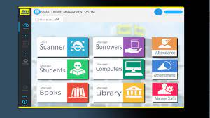
Conclusion
In conclusion, the Library Management System developed using Spring Boot offers an efficient and user-friendly solution for managing library operations.
The project incorporates key features such as book management, user registration, borrowing and returning of books, and administrative functions.
By leveraging the power of Spring Boot framework, the system provides a robust and scalable platform that ensures smooth and secure library operations.
The implementation of this project demonstrates the successful integration of modern technologies and best practices, resulting in an effective solution for streamlining library management processes.

Slide 14

Future Work
Integrating advanced search and recommendation algorithms could improve the system
Expanding the system to support multi-branch libraries or inter-library Loan functionality would provide users
Furthermore, implementing data analytics and reporting features would enable administrators to gain valuable insights.
Introducing social features like user reviews, ratings, and book recommendations

Slide 15
References
https://www.javatpoint.com/spring-security-form-based-authentication
https://www.javatpoint.com/spring-mvc-tutorial
https://www.youtube.com/watch?v=y8zyPlIdTyE&list=PL0zysOflRCelAb51IrexpUSeB0dpr9p6g
https://www.javaguides.net/2018/10/java-jdbc-api-overview.html
https://www.javatpoint.com/spring-boot-jpa
https://spring.io/blog/2021/12/17/client-side-development-with-spring-boot-applications
https://dzone.com/articles/introduction-to-thymeleaf-in-spring-boot
https://www.javatpoint.com/spring-boot-tutorial
https://www.javaguides.net/2022/12/spring-boot-3-crud-restful-webservices.html

Slide 16
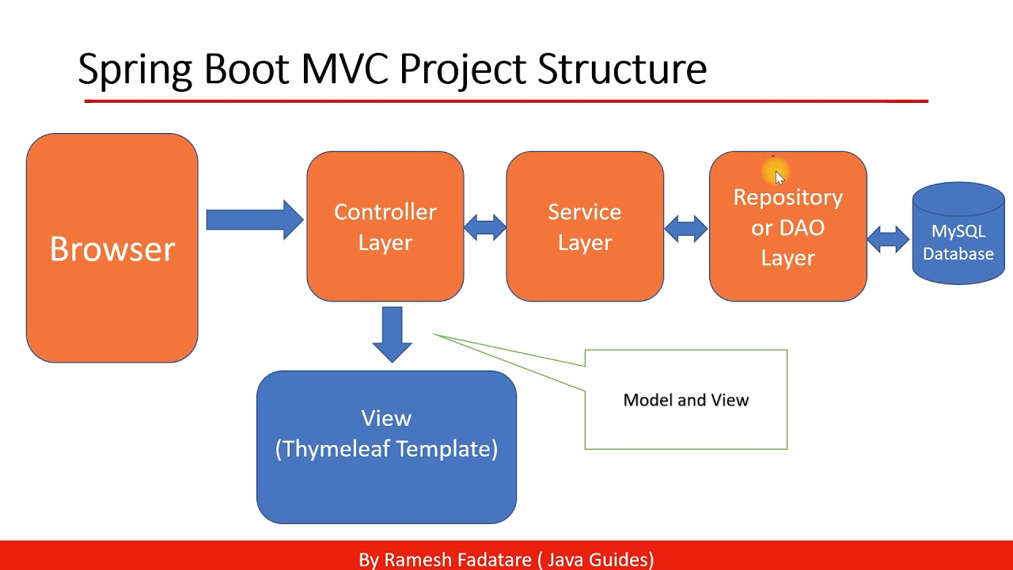
Appendices
This section includes any additional materials that support the project, such as screenshots, code snippets, or diagrams.

Slide 17
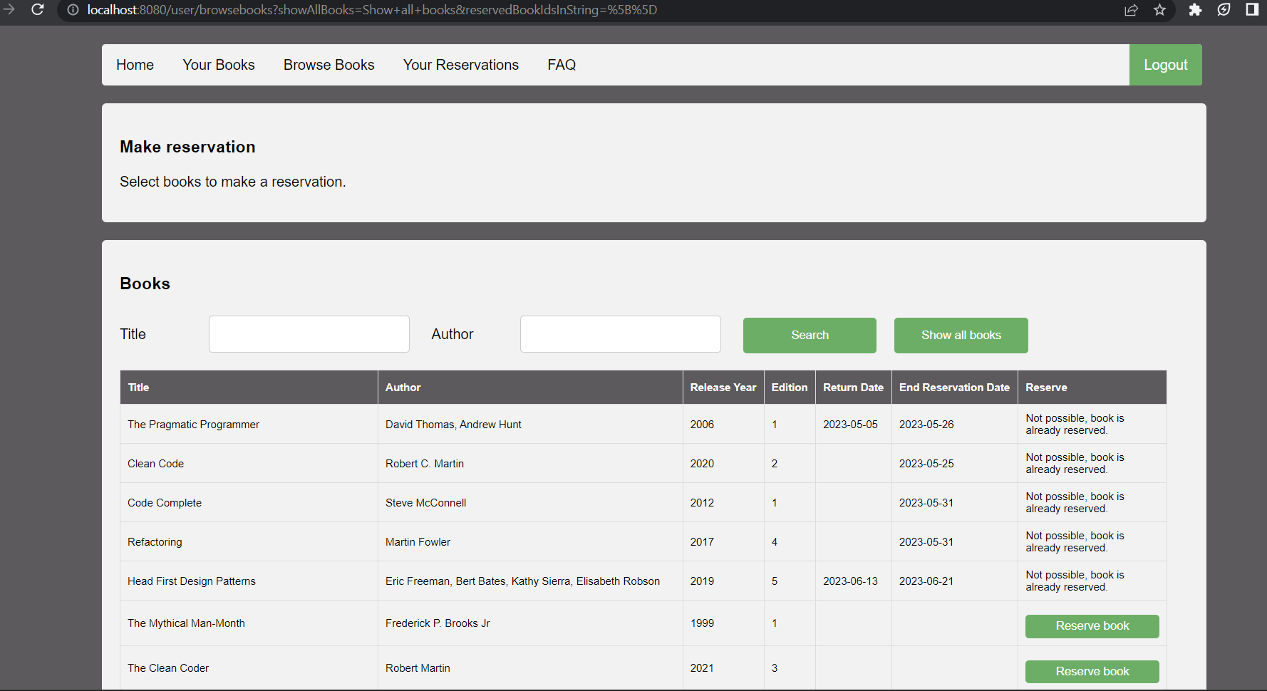

Slide 18
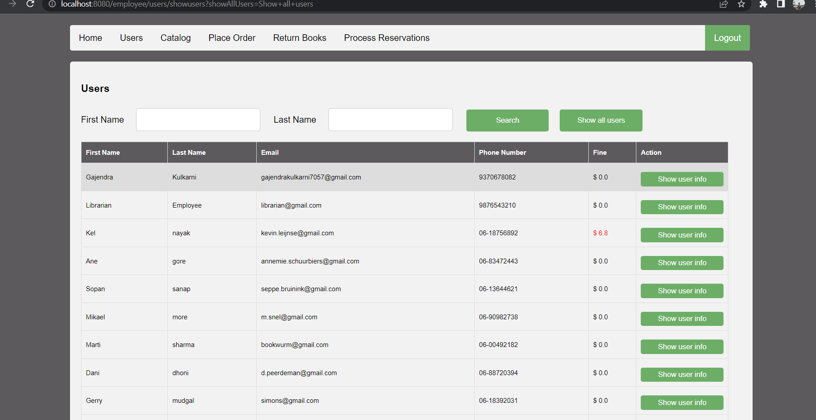

Slide 19
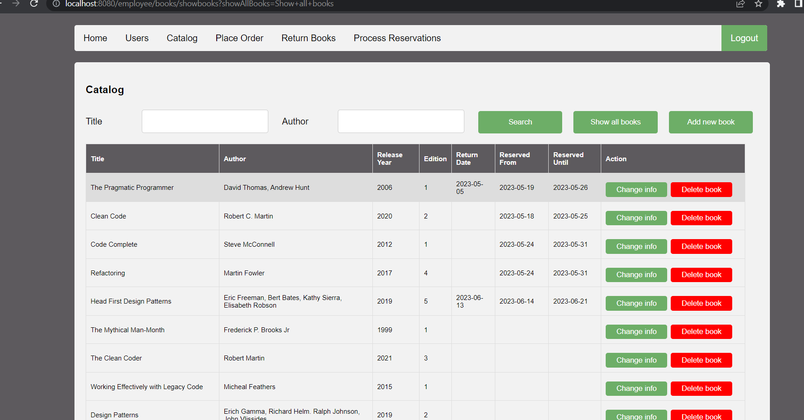

Slide 20
